Slide 1

Chapter 1 Introduction to Computers, Programs, and C++

Slide 2
Objectives
To review computer basics, programs, and operating systems (§1.2-1.4).
(Optional) To represent numbers in binary, decimal, and hexadecimal (§1.5 Optional).
To know the history of C++ (§1.6).
To write a simple C++ program (§1.7).
To understand the C++ program development cycle (§1.8).
To develop C++ using C++Builder (§1.9).
To develop C++ using command line tools on Windows (§1.10).
To develop C++ using command line tools on Unix (§1.11).
To develop C++ using Visual C++.Net (§1.12).

Slide 3

What is a Computer?
A computer consists of a CPU, memory, hard disk, floppy disk, monitor, printer, and communication devices.

Slide 4

CPU
The central processing unit (CPU) is the brain of a computer. It retrieves instructions from memory and executes them. The CPU speed is measured in megahertz (MHz), with 1 megahertz equaling 1 million pulses per second. The speed of the CPU has been improved continuously. If you buy a PC now, you can get an Intel Pentium 4 Processor at 3 gigahertz (1 gigahertz is 1000 megahertz).

Slide 5

Memory
Memory is to store data and program instructions for CPU to execute. A memory unit is an ordered sequence of bytes (not bits), each holds eight bits. A program and its data must be brought to memory before they can be executed. This is the principle of program storage. A memory byte is never empty, but its initial content may be meaningless to your program. The current content of a memory byte is lost whenever new information is placed in it.

Slide 6

How Data is Stored?
Data of various kinds, such as numbers, characters, and strings, are encoded as a series of bits (zeros and ones). Computers use zeros and ones because digital devices have two stable states, which are referred to as zero and one by convention. The programmers need not to be concerned about the encoding and decoding of data, which is performed automatically by the system based on the encoding scheme. The encoding scheme varies. For example, character ‘J’ is represented by 01001010 in one byte. A small number such as three can be stored in a single byte. If computer needs to store a large number that cannot fit into a single byte, it uses a number of adjacent bytes. No two data can share or split a same byte. A byte is the minimum storage unit.

Slide 7

Storage Devices
Memory is volatile, because information is lost when the power is off. Programs and data are permanently stored on storage devices and are moved to memory when the computer actually uses them. There are three main types of storage devices:Disk drives (hard disks and floppy disks), CD drives (CD-R and CD-RW), and Tape drives.

Slide 8

Output Devices: Monitor
The monitor displays information (text and graphics). The resolution and dot pitch determine the quality of the display.
Notes:
Dot pitch 点距

Slide 9
Monitor Resolution and Dot Pitch
resolution
The resolution specifies the number of pixels per square inch. Pixels (short for “picture elements”) are tiny dots that form an image on the screen. The resolution can be set manually. The higher the resolution, the sharper and clearer the image is. However, the image may be very small if you set high resolution on a small screen monitor. PC monitors are usually 15-inch, 17-inch, 19-inch, or 21-inch. For a 15-inch monitor, a comfortable resolution setting would be 640×480 (307,200 pixels).
dot pitch
The dot pitch is the amount of space between pixels. The smaller the dot pitch, the better the display.

Slide 10

Communication Devices
A regular modem uses a phone line and can transfer data in a speed up to 56,000 bps (bits per second). A DSL (digital subscriber line) also uses a phone line and can transfer data in a speed 20 times faster than a regular modem. A cable modem uses the TV cable line maintained by the cable company. A cable modem is as fast as a DSL. Network interface card (NIC) is a device to connect a computer to a local area network (LAN). The LAN is commonly used in business, universities, and government organizations. A typical type of NIC, called 10BaseT, can transfer data at 10 mbps (million bits per second).
Notes:
Digital Subscriber Line: 数字用户线路

Slide 11
What is a program?
Computer programs, known as software, are instructions to the computer.
You tell a computer what to do through programs. Without programs, a computer is an empty machine. Computers do not understand human languages, so you need to use computer languages to communicate with them.
Programs are written using programming languages.

Slide 12
Programming Languages
Machine Language Assembly Language High-Level Language
Machine language is a set of primitive instructions built into every computer. The instructions are in the form of binary code, so you have to enter binary codes for various instructions. Program with native machine language is a tedious process. Moreover the programs are highly difficult to read and modify. For example, to add two numbers, you might write an instruction in binary like this:
  1101101010011010

Slide 13
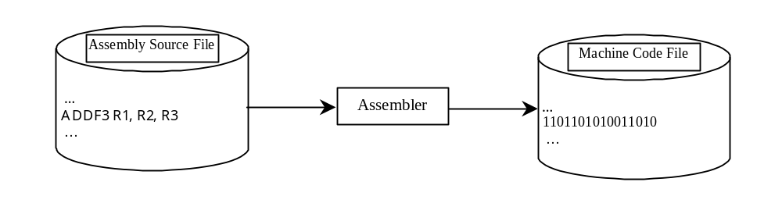
Programming Languages
Machine Language Assembly Language High-Level Language
Assembly languages were developed to make programming easy. Since the computer cannot understand assembly language, however, a program called assembler is used to convert assembly language programs into machine code. For example, to add two numbers, you might write an instruction in assembly code like this:
ADD R1, R2, R3

Slide 14
Programming Languages
Machine Language Assembly Language High-Level Language
The high-level languages are English-like and easy to learn and program. For example, the following is a high-level language statement that computes the area of a circle with radius 5:
area = 5 * 5 * 3.1415;

Slide 15
Popular High-Level Languages
COBOL (COmmon Business Oriented Language)
FORTRAN (FORmula TRANslation)
BASIC (Beginner All-purpose Symbolic Instructional Code)
Pascal (named for Blaise Pascal)
Ada (named for Ada Lovelace)
C (whose developer designed B first)
Visual Basic (Basic-like visual language developed by Microsoft)
Delphi (Pascal-like visual language developed by Borland)
C++ (an object-oriented language, based on C)
Java (a popular object-oriented language, similar to C++)
C# (a Java-like developed my Microsoft)

Slide 16
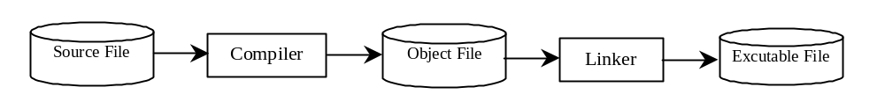
Compiling Source Code
A program written in a high-level language is called a source program. Since a computer cannot understand a source program. Program called a compiler is used to translate the source program into a machine language program called an object program. The object program is often then linked with other supporting library code before the object can be executed on the machine.

Slide 17
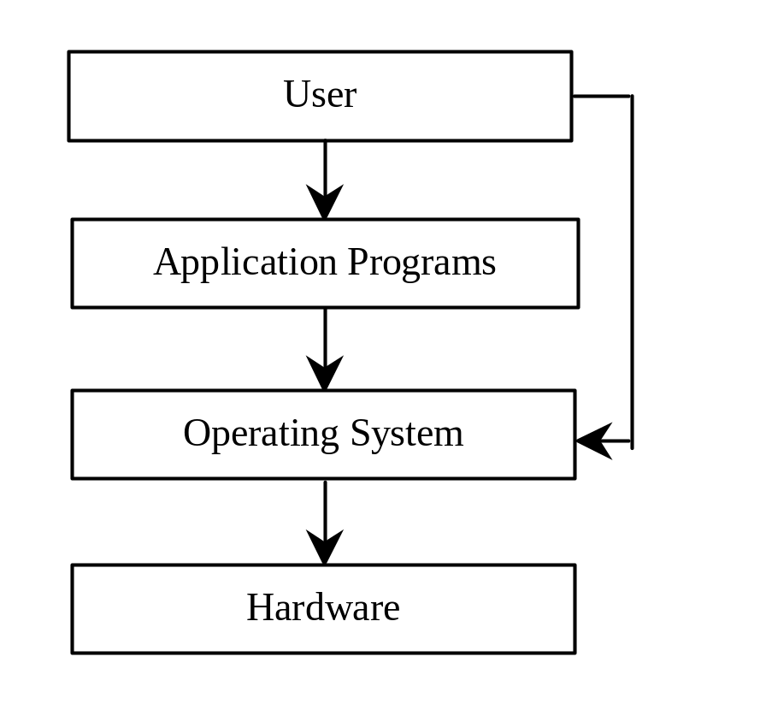
Operating Systems
The operating system (OS) is a program that manages and controls a computer’s activities. You are probably using Windows 98, NT, 2000, XP, or ME. Windows is currently the most popular PC operating system. Application programs such as an Internet browser and a word processor cannot run without an operating system.

Slide 18
Number Systems
NOTE: You can skip this section and use it as reference when you have questions regarding binary and hexadecimal numbers.
binary
0, 1
0, 1, 2, 3, 4, 5, 6, 7
0, 1, 2, 3, 4, 5, 6, 7, 8, 9
0, 1, 2, 3, 4, 5, 6, 7, 8, 9, A, B, C, D, E, F
octal
decimal
hexdecimal
Notes:
English words include binary, octal, decimal and hexdecimal.

Slide 19
Number Systems
Computers use binary numbers internally because storage devices like memory and disk are made to store 0s and 1s. A number or a text inside a computer is stored as a sequence of 0s and 1s. Each 0 and 1 is called a bit, short for binary digit. The binary number system has two digits, 0 and 1.
Binary numbers are not intuitive, since we use decimal numbers in our daily life. When you write a number like 20 in a program, it is assumed to be a decimal number. Internally, computer software is used to convert decimal numbers into binary numbers, and vice versa.

Slide 20
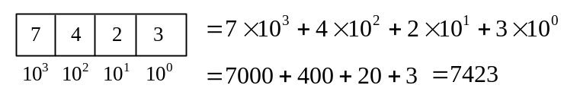
Number Systems, cont.
The digits in the decimal number system are 0, 1, 2, 3, 4, 5, 6, 7, 8, and 9. A decimal number is represented using a sequence of one or more of these digits. The value that each digit in the sequence represents depends on its position. A position in a sequence has a value that is an integral power of 10. For example, the digits 7, 4, 2, and 3 in decimal number 7423 represent 7000, 400, 20, and 3, respectively, as shown below:
The decimal number system has ten digits and the position values are integral powers of 10. We say that 10 is the base or radix of the decimal number system. Similarly, the base of the binary number system is 2 since the binary number system has two digits and the base of the hex number system is 16 since the hex number system has sixteen digits.

Slide 21
Number Systems, cont.
Binary numbers tend to be very long and cumbersome. Hexadecimal numbers are often used to abbreviate binary numbers. The hexadecimal number system has 16 digits: 0, 1, 2, 3, 4, 5, 6, 7, 8, 9, A, B, C, D, E, and F. The letters A, B, C, D, E, and F correspond to the decimal numbers 10, 11, 12, 13, 14, and 15.

Slide 22

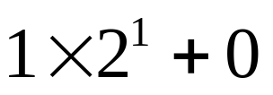

Binary Numbers => Decimals
Given a binary number
the equivalent decimal value is
10 in binary
= 2 in decimal
1000 in binary
= 8 in decimal
10101011 in binary
= 171 in decimal

Slide 23

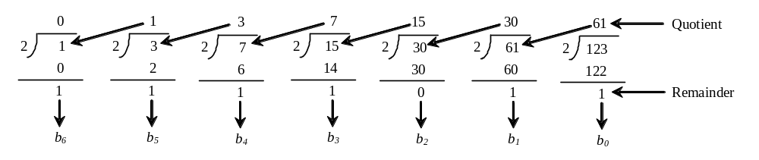
Decimals => Binary
To convert a decimal number d to a binary number is to find the binary digits.. such that
These numbers can be found by successively dividing d by 2 until the quotient is 0. The remainders are
For example, the decimal number 123 is 1111011 in binary. The conversion is conducted as follows:

Slide 24
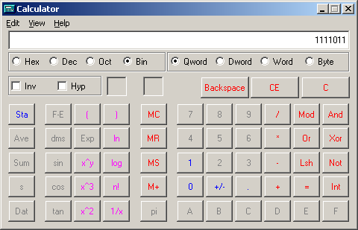
Windows Calculator
The Windows Calculator is a useful tool for performing number conversions. To run it, choose Programs, Accessories, and Calculator from the Start button.

Slide 25

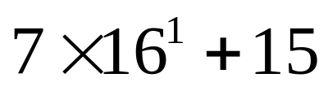

Hexadecimals => Decimals
The hexadecimal number system has sixteen digits: 0, 1, 2, 3, 4, 5, 6, 7, 8, 9, A, B, C, D, E, and F. The letters A, B, C, D, E, and F correspond to the decimal numbers 10, 11, 12, 13, 14, and 15. Given a hexadecimal number
The equivalent decimal value is
7F in hex
= 127 in decimal
FFFF in hex
= 65535 in decimal

Slide 26

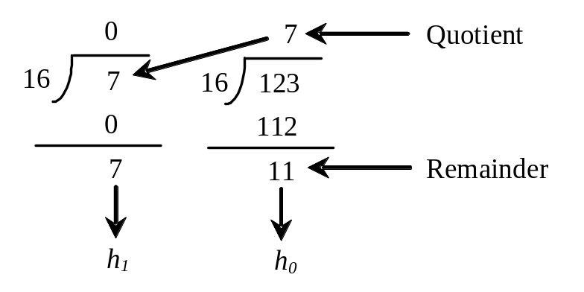

Decimals => Hexadecimal
To convert a decimal number d to a hexadecimal number is to find the hexadecimal digits hn, hn-1, hn-2, ... such that
These numbers can be found by successively dividing d by 16 until the quotient is 0. The remainders are
For example, the decimal number 123 is 7B in hexadecimal. The conversion is conducted as follows:

Slide 27
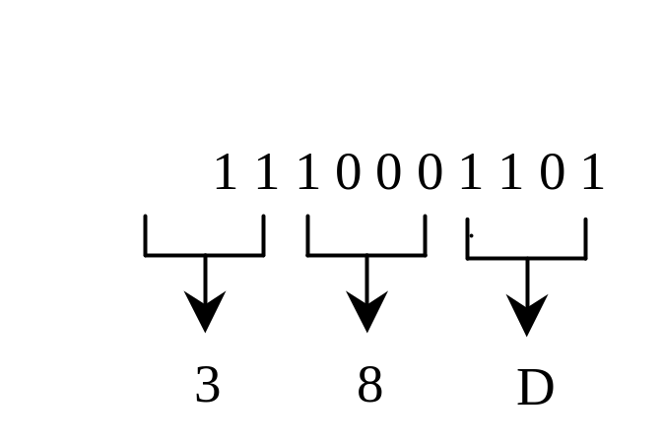
Hexadecimal ⬄ Binary
Binary Hex Decimal
To convert a hexadecimal number to a binary number, simply convert each digit in the hexadecimal number into a four-digit binary number.
0000 0 0
0001 1 1
0010 2 2
0011 3 3
0100 4 4
0101 5 5
0110 6 6
0111 7 7
1000 8 8
1001 9 9
1010 A 10
1011 B 11
1100 C 12
1101 D 13
1110 E 14
1111 F 15
To convert a binary number to a hexadecimal, convert every four binary digits from right to left in the binary number into a hexadecimal number. For example,

Slide 28
History of C++
C, C++, Java, and C# are very similar. C++ evolved from C. Java was modeled after C++. C# is a subset of C++ with some features similar to Java. If you know one of these languages, it is easy to learn the others.
C evolved from the B language and the B language evolved from the BCPL language. BCPL was developed by Martin Richards in the mid-1960s for writing operating systems and compilers.
C++ is an extension of C, developed by Bjarne Stroustrup at Bell Labs during 1983-1985. C++ added a number of features that improved the C language. Most importantly, it added the
An international standard for C++ was created by American National Standards Institute (ANSI) in 1998. The ANSI
Notes:
C# and Java

Slide 29
A Simple C++ Program
Let us begin with a simple C++ program that displays the message “Welcome to C++!” on the console.
// Program is generally composed of predefined head and at least
// one main function.
// iostream is a system library file
// include is predefined identifier
#include <iostream>
// the following is main function
int main() // main function header
{
// Display Welcome to C++ to the console
// std is a namespace
std::cout << "Welcome to C++!" << std::endl;
return 0;
}
Notes:
Enlish words include predefined head and function.
Function is composed of function header and function body.

Slide 30
Notation
# pound
* Asterisk
. full stop
, comma
; semicolon
: colon
? question mark
! Exclamation mark
… ellipse
< left/open angle bracket
{ left/open brace
( left/open parenthese
[ left/open bracket
“” double quotation mark
‘’ single quotation mark

Slide 31
Extending the Simple C++ Program
Once you understand the program, it is easy to extend it to display more messages. For example, you can rewrite the program to display three messages, as shown in Listing 1.2.
#include <iostream>
int main()
{
std::cout << "Welcome to C++!" << std::endl;
std::cout << "Welcome to C++Builder!" << std::endl;
std::cout << "Welcome to C++ Compiler!" << std::endl;
return 0;
}

Slide 32
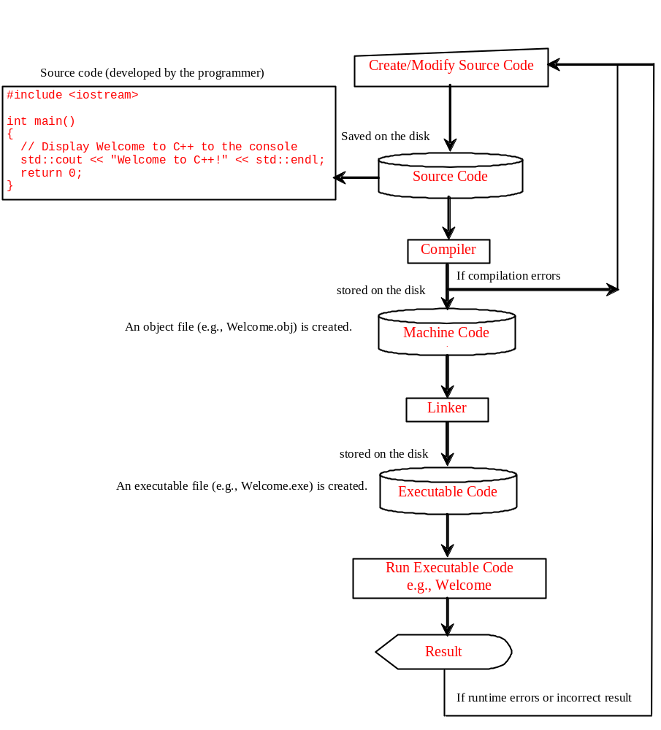
Creating, Compiling, and Running Programs

